Slide 1


Mission:
Expand educational opportunities and enhance the state’s economic and workforce development by providing cost-effective financing programs for post-secondary education, scholarships, and information resources to Connecticut students, alumni and their families.

Slide 2

CHESLA Programs
The Connecticut Higher Education Supplemental Loan Authority (CHESLA) is a state affiliated not-for-profit entity created to help students and their families finance the cost of higher education.
Our Programs and Resources:
CT Dollars & Sense Financial Literacy Portal
Scholarships
CHESLA Outreach Program
MyCHESLA Student Loans
Refi CT Refinancing Student Loans
Employer Repayment Program
Alliance District Loan Subsidy Program

Slide 3


Financial Literacy
Financial literacy portal created by CHESLA and other state agencies
    Treasurer’s Office, Office of Higher Education, Department of Consumer Protection, Department of Banking
Launched in February 2017
One-stop shop with information and resources to plan, save and pay for college that includes :
  Scholarship Center
  Financial Aid Articles/Information
  Calculators and much more!
www.ctdollarsandsense.com

Slide 4


Scholarships
Purpose: To provide need-based college scholarships to Connecticut residents attending Connecticut public or private non-profit degree granting institutions of higher education within the state. The awards provide students with additional assistance, other than loans, to finance their college education.
Disbursed over $11.9 million in scholarship funds, impacting 6,115 students.
Scholarship application annual open dates
    Students pursuing an undergraduate degree: March 1st
    Students pursuing a healthcare, manufacturing or ARC Teaching Certificate Program certificate: July 1st
    DACA Students and or students pursuing a graduate degree: July 1st

Slide 5

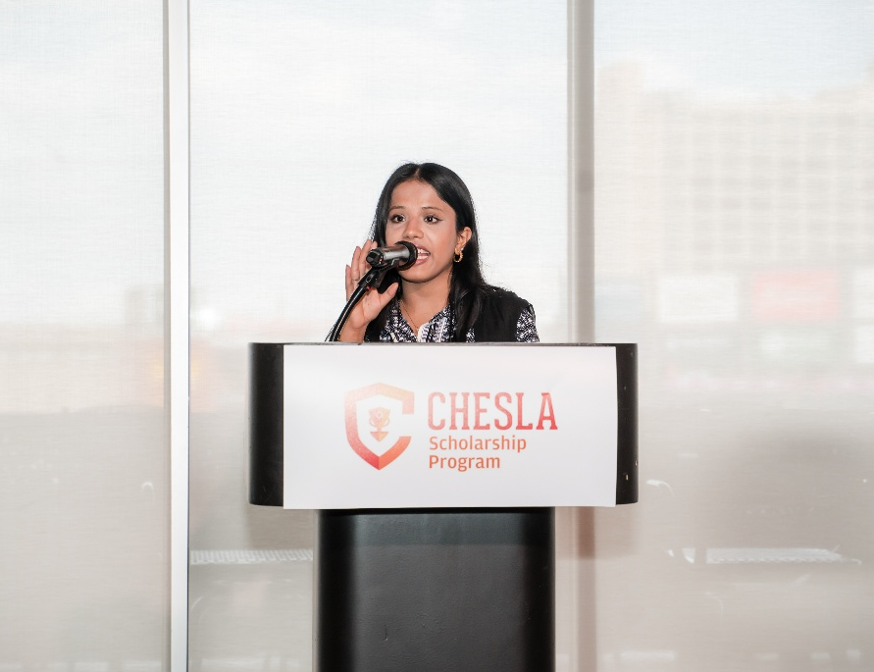



Scholarships
Recent Award Year
185 Scholarship Recipients
A total of $532,500 in scholarships awarded to undergraduate students
Scholarships were awarded to students representing 61 towns and attending 17 of the state’s 34 public or non-profit higher education institutions.

Slide 6

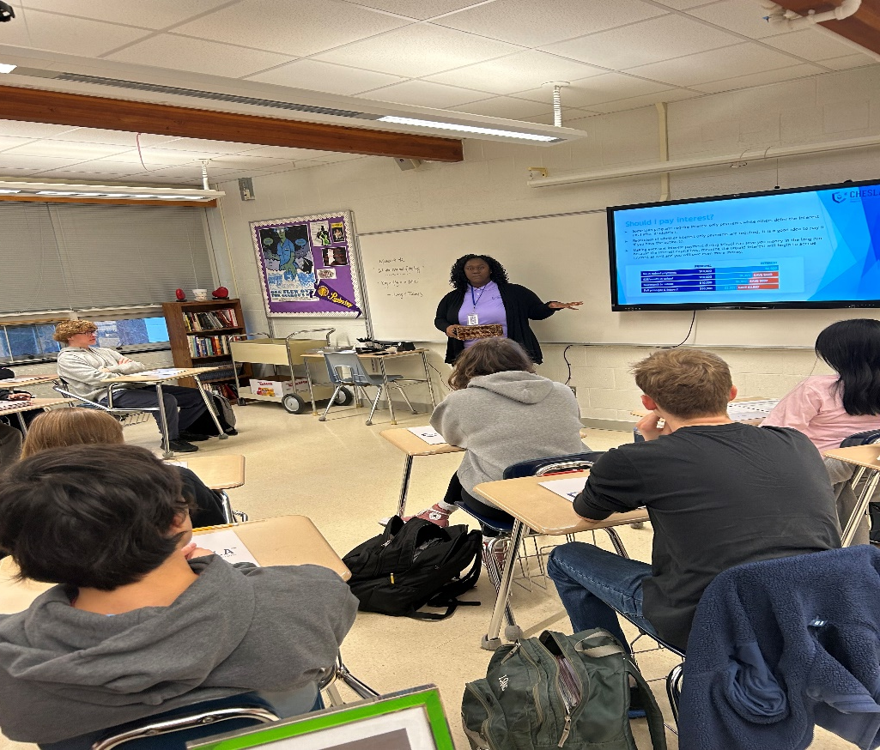
CHESLA Outreach Program
The purpose of this program is to provide students and families with the information they need to go through the financial aid and paying for college process.
A FREE Financial Aid Basics presentation geared towards high school juniors and seniors.
The presentation highlights information about the FAFSA, Financial Aid Award Letter, comparing colleges financially, understanding how interest works, and more.
Since the inception of the Outreach Program in 2019, CHESLA has presented to almost 40 Financial Aid sessions.

Slide 7


Student Loans
Serves students in or from the State of Connecticut
Loans are funded from tax-exempt bonds issued and paid by CHESLA, but also backed by the State of Connecticut.
Historically, the program has disbursed $614.3 million across 61,170 loans.
Designed to help after financial aid, scholarships, and Direct Subsidized & Direct Unsubsidized federal loans.
Compare to the Parent PLUS and other private loans
No application deadline. Apply anytime after receiving your Financial Aid package from the school.
Current Loan Offering:
    Non-tiered fixed interest rate of 6.65%
    140-month repayment term
    No fees!
    Borrowing Limits: a minimum of $2,000 to up a cumulative maximum principal balance outstanding of $125,000

Slide 8


Refinancing opportunities
Launched at the end of June 2016
Serves Connecticut residents refinancing any school-certified student loan and borrowers refinancing a prior CHESLA loan.
Offer personalized refinancing analysis before applying
Designed to help professionals that may be struggling to manage their student loan debt.
On average Refi CT borrowers are reducing their interest rate by 2.50%.
Historically, the program has disbursed over $24.3 million across 468 loans.
Current program features include:
    Tiered fixed rates based on credit scores and loan term
    Fixed rates as low as 4.99%* with a co-signer, or 5.25%* without a co-signer; APRs range from 4.99% to 7.74% across all credit tiers and loan terms
    (*0.25% ACH interest rate reduction is available)
    5-, 10-, and 15-year repayment term options
    No fees!

Slide 9


Employer Student Loan Support Program
CHESLA and RISLA are quasi-public state authorities created to help students and families finance the cost of higher education.
CHESLA has partnered with its Rhode Island counterpart, RISLA, to offer a robust program for employers. CHESLA offers its financing programs, while RISLA handles the student loan repayment processing.
The dynamic CHESLA/RISLA partnership works with Human Resources teams to identify employees with student loan debt.
We customize a benefit package based on unique employer needs.

Slide 10
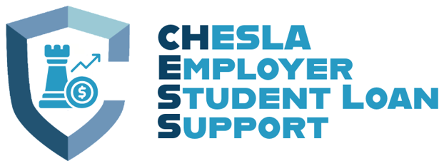
benefits
FEDERAL BENEFITS
Employers can make tax-free payments up to $5,250* annually per employee
  *This includes both tuition assistance and employer student loan repayment programs
  Tuition assistance and employer repayment complement one another
Qualifying payments:
  Both federal and private student loans
  Payments for principal or interest on qualified education loan
Both employers and employees save on federal payroll taxes for qualifying payments
Employees save on federal income taxes for qualifying payments
Permanent Federal incentives.
CONNECTICUT BENEFITS
If a company pays down any student loans in repayment on behalf of its employees, the company may be eligible for a State of Connecticut tax credit
How employers qualify for the credit:
  Employ the qualified employee
  Be subject to corporate business tax or insurance premium tax
Qualified employees must:
  Connecticut resident
  Has earned their bachelor's degree from an institution of higher education in the immediately preceding five-year period
  Employed full-time in Connecticut by a qualified employer
  Not an owner, member or partner of such qualified employer or a family member of an owner, member or partner of such qualified employer
  Has an eligible student education loan

Slide 11

Alliance District Loan Subsidy Program
This program offers an interest rate subsidy on Alliance District Educator and Counselor Refinance Loans (to refinance existing private student loan debt, also known as non-federal loans) to teachers, paraeducators, and school counselors in any of Connecticut’s Alliance District public schools. The program is designed to attract, support, and retain high quality educators and counselors.
The maximum available Alliance District Refinance Loan per teacher is $25,000. The minimum loan amount is $5,000.*
Educators or Counselors approved for an Alliance District Refinance Loan will receive a 3-percentage-point subsidy on the Refinance Loan rate for as long as they continue to be employed in an Alliance District public school.
Rates on Alliance District Teacher Refinance Loans, including the 3% subsidy, range from 0.75% to 2.49%, with terms of 5, 10, or 15 years.
To be eligible an applicant must:
  Be a teacher, paraeducator, or school counselor in an Alliance District public school (teachers must maintain a current Connecticut Educator Certification)
  Submit an Alliance District Refinance Loan application
  Be the refinancing borrower on the private student loan
  Have a FICO score of at least 580
  Request refinancing for a private student loan (federal loans are not eligible for refinancing through this program)
  Have no account that is 90+ days late in the past twelve months
  Have no education loans in default

Slide 12


Frequently Asked Questions

Slide 13
General In-School Questions
Do I have to be 18 to apply for a loan?
In Connecticut you can apply under the age of 18 with a co-borrower. Out of state residents attending college in Connecticut must be 18 years old.
When should I apply for a loan?”
There is no application deadline. A student should apply after he or she receives a financial aid award letter from a college and has determined the amount of additional funds needed.
How long does the application process take?”
The review and processing of an application takes no longer than 2 weeks. The school will then need to certify the loan and there is a required rescission period. At that point, the school will set a disbursement date with the loan servicer.
What fees are required?”
There are NO FEES with CHESLA Loans!
13

Slide 14
"I am a teacher in a Connecticut Alliance District. Do I qualify for this program?“
Teaching in a Connecticut Alliance District makes a teacher eligible to apply for this program. The teacher must also have a FICO score of at least 580.
"Is this free money?“
No, this is a refinance student loan that is paid back plus the interest rate. The benefit is that Connecticut Alliance District teachers receive a 3% subsidy to their interest rate as long as they continue to teach in a Connecticut Alliance District.
"Can I refinance loans that I am a co-signer on?”
No, the teacher must be the borrower on the underlying loans that financed the teacher's higher education.
"Can I refinance my Department of Education student loans?”
No, any student loans through the Department of Education and federal government are federal loans. This program only refinances private loans.
This is because refinancing any federal loans would impact federal benefits, such as Teacher Loan Forgiveness and Public Service Loan Forgiveness. This also includes any potential federal loan forgiveness from the President. Anytime federal loans are refinanced away from the federal government, those federal benefits are lost.
"Can I refinance loans my Parent PLUS loans?”
No, Parent PLUS loans are federal loans, and the underlying loans must have financed the teacher's higher education.
“What loans are private loans”
Any student loans that are NOT through the Department of Education and federal government are considered to be private loans.
“What fees are required?”
There are NO FEES with the program!
Alliance District Teacher Loan Subsidy Questions

Slide 15

Contact Us:
Shannon Reynolds, Senior Program Specialist-Marketing & Outreach
Email: sreynolds@chesla.org
Phone Number: (860) 761-8484

